Slide 1
Database Management Systems
Relational Algebra Operations

Slide 2
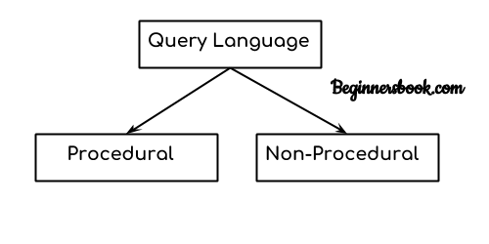
Relational Algebra
In simple words, a Language which is used to store and retrieve data from database is known as query language. For example – SQL
There are two types of query language:
1.Procedural Query language
2.Non-procedural query language

Slide 3
Procedural Query language: In procedural query language, user instructs the system to perform a series of operations to produce the desired results. Here users tells what data to be retrieved from database and how to retrieve it.
For example – Let’s take a real world example to understand the procedural language, you are asking your younger brother to make a cup of tea, if you are just telling him to make a tea and not telling the process then it is a non-procedural language, however if you are telling the step by step process like switch on the stove, boil the water, add milk etc. then it is a procedural language.
2. Non-procedural query language: In Non-procedural query language, user instructs the system to produce the desired result without telling the step by step process. Here users tells what data to be retrieved from database but doesn’t tell how to retrieve it.
Now let’s back to our main topic of relational algebra and relational calculus.

Slide 4
Relational Algebra:
Relational algebra is a conceptual procedural query language used on relational model.
Relational Calculus:
Relational calculus is a conceptual non-procedural query language used on relational model.
Note:
I have used word conceptual while describing relational algebra and relational calculus, because they are theoretical mathematical system or query language, they are not the practical implementation, SQL is a practical implementation of relational algebra and relational calculus.

Slide 5
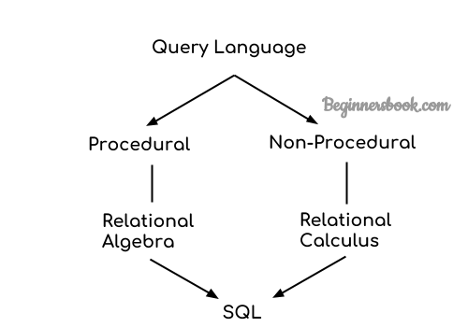

Slide 6
RELATIONAL ALGEBRA OPERATIONS
Unary Relational Operations
SELECT
PROJECT
RENAME
Relational Algebra Operations From Set Theory
UNION
INTERSECTION
DIFFERENCE

Slide 7
Unary Relational Operations
SELECT (σ)
σ_{p}(r)
σ is the predicate
r stands for relation which is the name of the table
p is prepositional logic

Slide 8
Select Operator (σ) Example
Table: CUSTOMER
Customer_Id Customer_Name Customer_City
CN00121 Shivendra Mumbai
CN00123 Mohit Mumbai
CN00125 Karan Noida
CN00127 Aman Delhi
CN00130 Virat Delhi
Query:
σ _{Customer_City="Mumbai"} (CUSTOMER)
Output:
Customer_Id Customer_Name Customer_City
CN00121 Shivendra Mumbai
CN00123 Mohit Mumbai

Slide 9
Select Operator (σ) Example
For example,
To select the tuples for all employees who either work in department 4 and make over $25,000 per year,
or work in department 5 and make over $30,000,
we can specify the following SELECT operation:
^{σ}(Dno=4 AND Salary>25000) OR (Dno=5 AND Salary>30000)^{(EMPLOYEE)}

Slide 10
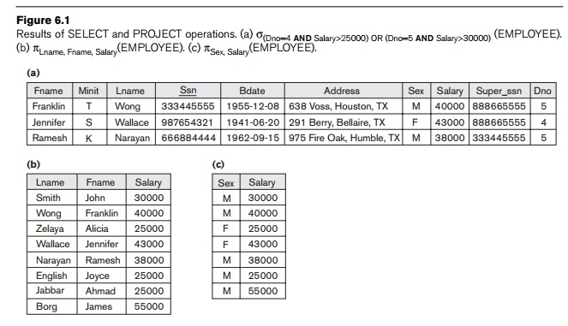

Select Operator (σ) Example

Slide 11
Select Operator (σ) Example
All the selected tuples appear in the result of the SELECT operation.
The Boolean conditions AND, OR, and NOT have their normal interpretation, as follows:
(cond1 AND cond2) is TRUE if both (cond1) and (cond2) are TRUE;
otherwise, it is FALSE.
(cond1 OR cond2) is TRUE if either (cond1) or (cond2) or both are TRUE;
otherwise, it is FALSE.
(NOT cond) is TRUE if cond is FALSE; otherwise, it is FALSE.

Slide 12
Project Operator (∏)
Project operator is denoted by ∏ symbol and it is used to select desired columns (or attributes) from a table (or relation).
Project operator in relational algebra is similar to the Select statement in SQL.

Slide 13
Table: CUSTOMER
Customer_Id Customer_Name Customer_City
CN00121 Shivendra Mumbai
CN00123 Mohit Mumbai
CN00125 Karan Noida
CN00127 Aman Delhi
CN00130 Virat Delhi
Query:
∏ _{Customer_Name, Customer_City} (CUSTOMER)
Output:
Customer_Name Customer_City
Shivendra Mumbai
Mohit Mumbai
Karan Noida
Aman Delhi
Virat Delhi

Slide 14
Project Operator (∏)
For example, to list each employee’s first and last name and salary,
we can use the PROJECT operation as follows:
^{π}Lname, Fname, Salary^{(EMPLOYEE)}
The resulting relation is shown in Figure 6.1(b)

Slide 15

Project Operator (∏) Example

Slide 16
Project Operator (∏) Example
The PROJECT operation removes any duplicate tuples,
so the result of the PROJECT operation is a set of distinct tuples, and hence a valid relation.
This is known as duplicate elimination.
For example, consider the following PROJECT operation:
π_{Sex,} _{Salary}(EMPLOYEE)

Slide 17
The relations shown in Figure 6.1 that depict operation results do not have any names.
In general, for most queries, we need to apply several relational algebra operations one after the other.
Either we can write the operations as a single relational algebra expression by nesting the operations, or we can apply one operation at a time and create intermediate result relations.

Slide 18
For example, to retrieve the first name, last name, and salary of all employees
who work in depart-ment number 5,
we must apply a SELECT and a PROJECT operation.
We can write a single relational algebra expression,
also known as an in-line expression, as follows:
^{π}Fname, Lname, Salary (^{σ}Dno=5 (^{EMPLOYEE ))}

Slide 19
Rename (ρ)
Rename (ρ) operation can be used to rename a relation or an attribute of a relation.
Rename (ρ) Syntax:
ρ(new_relation_name, old_relation_name)

Slide 20
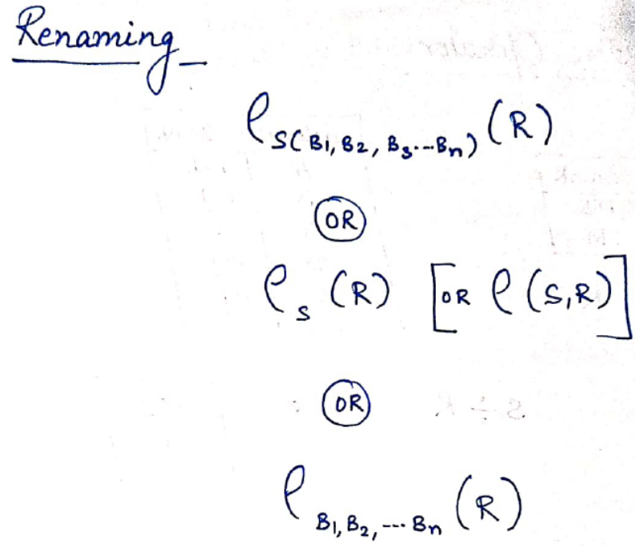
Ways of renaming Relation/attribute/Both
S-new relation name
R-old relation name
B1,B2….new attribute name

Slide 21
Rename (ρ) Example
Table: CUSTOMER
Customer_Id Customer_Name Customer_City
CN00121 Shivendra Mumbai
CN00123 Mohit Mumbai
CN00125 Karan Noida
CN00127 Aman Delhi
CN00130 Virat Delhi
Query:
ρ(CUST_NAMES, ∏(Customer_Name)(CUSTOMER))
Output:
CUST_NAMES
----------
Shivendra
Mohit
Karan
Aman
Virat

Slide 22
Alternatively, we can explicitly show the sequence of operations,
giving a name to each intermediate relation, as follows:
TEMP ← σ_{Dno=5}(EMPLOYEE)
R ← π_{Fname,} _{Lname,} _{Salary}(TEMP)

Slide 23
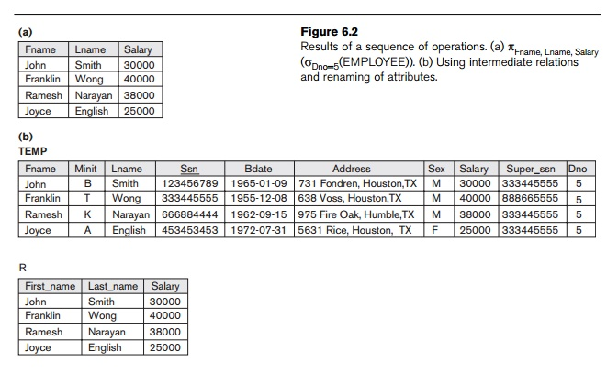
To rename the attributes in a relation,
we simply list the new attribute names in parentheses,
as in the following example:
TEMP ← σ_{Dno=5}(EMPLOYEE)
R(First_name, Last_name, Salary) ← π_{Fname,} _{Lname,} _{Salary}(TEMP)

Slide 24
EXAMPLE:
branch (branch_name, branch_city, assets)
customer (customer_name, customer_street, customer_city)
account (account_number, branch_name, balance)
loan (loan_number, branch_name, amount)
depositor (customer_name, account_number)
borrower (customer_name, loan_number)
Find all loans of over $1200
Find customer name, account number of all depositors.
Find all account no. whose balance is less than $5000.
Find the loan number for each loan of an amount greater than $1200

Slide 25
Find all loans of over $1200
Find customer name, account number of all depositors.
Find all account no. whose balance is less than $5000.
Find the loan number for each loan of an amount greater than $1200

Slide 26
SOLUTION
σ_{amount > 1200} (loan)
∏ customer_name, account_number (Depositor)
∏ account_number (σ_{balance < 5000} (account))
∏_{loan_number} (σ_{amount} _{> 1200} (loan))

Slide 27
Relational Algebra
Relational algebra is the basic set of operations for the relational model
These operations enable a user to specify basic retrieval requests (or queries)
The result of an operation is a new relation, which may have been formed from one or more input relations
This property makes the algebra “closed” (all objects in relational algebra are relations)

Slide 28
The algebra operations thus produce new relations
These can be further manipulated using operations of the same algebra
A sequence of relational algebra operations forms
a relational algebra expression
The result of a relational algebra expression is also a relation that represents the result of a database query (or retrieval request).

Slide 29
Union Operator (∪)
The union operation allows us to combine two relations
Notation: r ∪ s
For r ∪ s to be valid.
1. r, s must have the same arity (same number of attributes)
2. The attribute domains must be compatible

Slide 30
Table 1: COURSE
Course_Id Student_Name Student_Id
C101 Aditya SI701
C104 Aditya SI701
C106 Shivendra SI705
C109 Prateek SI707
C115 Ruchika SI711
Table 2: STUDENT
Student_Id Student_Name Student_Age
SI701 Aditya 19
SI705 Shivendra 18
SI707 Prateek 19
SI711 Ruchika 17
S941 Virat 16
S951 Richa 18
Query:
∏ _{Student_Name} (COURSE) ∪ ∏ _{Student_Name} (STUDENT)
Output:
Student_Name
------------
Aditya
Virat
Prateek
Ruchika
Richa
Shivendra

Slide 31
Intersection Operation(∩)
The set-intersection operation allows us to find tuples that are in both the input relations.
Notation: r ∩ s
Assume:
r, s have the same arity
attributes of r and s are compatible

Slide 32
Table 1: COURSE
Course_Id Student_Name Student_Id
C101 Aditya SI701
C104 Aditya SI701
C106 Shivendra SI705
C109 Prateek SI707
C115 Ruchika SI711
Table 2: STUDENT
Student_Id Student_Name Student_Age
SI701 Aditya 19
SI705 Shivendra 18
SI707 Prateek 19
SI711 Ruchika 17
S941 Virat 16
S951 Richa 18
Query:
∏ _{Student_Name} (COURSE) ∩ ∏ _{Student_Name} (STUDENT)
Output:
Student_Name
------------
Aditya
Shivendra
Prateek
Ruchika

Slide 33
Set Difference Operation
The set-difference operation allows us to find tuples that are in one relation but are not in another.
Notation r – s
Set differences must be taken between compatible relations.
r and s must have the same arity
attribute domains of r and s must be compatible

Slide 34
Table 1: COURSE
Course_Id Student_Name Student_Id
C101 Aditya SI701
C104 Aditya SI701
C106 Shivendra SI705
C109 Prateek SI707
C115 Ruchika SI711
Table 2: STUDENT
Student_Id Student_Name Student_Age
SI701 Aditya 19
SI705 Shivendra 18
SI707 Prateek 19
SI711 Ruchika 17
S941 Virat 16
S951 Richa 18
Query:
∏ Student_Name (STUDENT) - ∏ Student_Name (COURSE)
Output:
Student_Name
------------
Virat
Richa

Slide 35
Relational Algebra Operations from Set Theory: SET DIFFERENCE
SET DIFFERENCE(also called MINUS or EXCEPT) is denoted by –
The result of R – S is a relation that includes all tuples that are in R but not in S
◉ The attribute names in the result will be the same as the attribute names in R
The two operand relations R and S must be “type compatible”

Slide 36
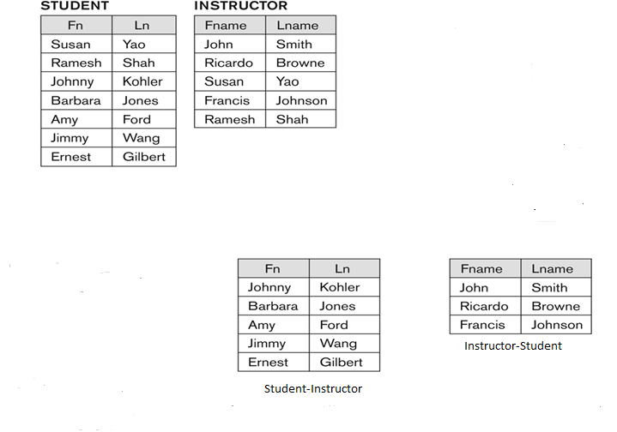
Example to illustrate the result of SET DIFFERENCE:

Slide 37
The minus operation is not commutative; that is, in general
  R – S ≠ S – R

Slide 38
DEPOSITOR RELATION
CUSTOMER_NAME | ACCOUNT_NO
Johnson | A-101
Smith | A-121
Mayes | A-321
Turner | A-176
Johnson | A-273
Jones | A-472
Lindsay | A-284

Slide 39
BORROW RELATION
CUSTOMER_NAME | LOAN_NO
Jones | L-17
Smith | L-23
Hayes | L-15
Jackson | L-14
Curry | L-93
Smith | L-11
Williams | L-17

Slide 40
Set Difference:
Suppose there are two tuples R and S. The set difference operation contains all tuples that are in R but not in S.
It is denoted by minus (-).
Notation: R - S
Example: Using the DEPOSITOR table and BORROW table
∏ CUSTOMER_NAME (BORROW) - ∏ CUSTOMER_NAME (DEPOSITOR)

Slide 41
Output:
CUSTOMER_NAME
Jackson
Hayes
Willians
Curry

Slide 42
Aggregate Functions
avg
min
max
sum
count

Slide 43
Aggregate Functions
takes a collection of values and returns a single value as a result.
avg: average value
min: minimum value
max: maximum value
sum: sum of values
count: number of values

Slide 44
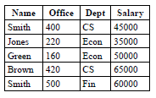

Find the minimum salary
F _{MIN (salary)} (EMP)

Slide 45
Find the maximun salary
F _{MAX (salary)} (EMP)

Slide 46

Find the average salary
F _{AVG (salary)} (EMP)

Slide 47

Count the number of employees in the CS
department
F _{COUNT (name)} σ ( _{Dept = 'CS'} (EMP) )

Slide 48

Find the total payroll for the Economics
Department
F _{SUM (salary)} σ (_{Dept = 'Econ'} (EMP) )

Slide 49
Thank
You

